Slide 1
Touch For Health: An Empirical Investigation of Physical Touch as Means of Improved Health Education
Siobhan Yilmaz & Alok K. Bohara
October 2017

Slide 2
Introduction & Background
Key goals in developing world are to improve health and education (particularly for women)
Role for health education, not just determination of direction of causality between health & education
Literature has coverage on determination of best practices:
Methods to improve knowledge
Methods to encourage technology adoption
This work seeks to examine a new potential “best practice” through a pilot RCT study
Notes:
Millenium Development Goals and now, Sustainable Development Goals:
Good health/weelbeing, gender equality, peace/justice with strong institutions

Slide 3
Why/How Health Educ. Through Schools?
Schools as Medium to Improve Hygiene/Health:
Decentralization efforts found to improve efficiency- better test scores and reduced infant mortality (Channa and Faguet, 2016)
Indicates better information on local needs/conditions can lead to better outcomes, and schools are traditionally managed/focused at local level
General Results Regarding Good Methods to Improve Learning:
Few messages, repeatedly, & in many forms (Loevinsohn, 1990)
Largest mean effect sizes from teacher training and instructional materials, followed by info. dissemination & improved school management (McEwan, 2015)
Approaches with holistic framing to allow for deeper understanding (Sharma, 2012)
RCT Evidence:
Kenya – official program on HIV/AIDS didn’t reduce pregnancy, informational intervention reduced incidence by 1.5% (Dupas, 2011)
India- toilets to schools got adolescent girls to keep coming (Adukai, 2017)
India – 10 session in-school informational intervention had 65% of girls adopting more than 13 preventative health-related behaviors (Kapadia-Kundu et al, 2014)

Slide 4
Gaps in Motivation to Adopt/Change Behavior Still Found
Macro International study found high rates of early initiation of sexual activity, risky behavior, inadequate knowledge about protection/transmission of STD’s (Singh, Bankole, & Woog, 2005)
Gaps in acceptability, knowledge, and behavior change:
Despite 30% of surveyed women in Hong Kong willing to take HPV vaccine, only between 2-9% actually receive it (Choi et al, 2013)
Study of sex education in four western world nations, determining that truth-based and not prescriptive abstinence education most impactful in terms of outcome statistics (Weaver et al, 2005)
Ethiopian study showing young people seek targeted care (special hours/prices) to incentivize utilization of healthcare services (Berhane et al, 2005)
Anti-obesity advertising must take into account weight of targeted audience to induce behavior change (Wang et al, 2015)
Notes:
Choi study→ HPV vaccines in Hong Kong where despite 30% of served women willing to take vaccine, only between 2-9% actually receive it
Weaver et al → Study of sex education in four western world nations, determining that truth-based and not prescriptive abstinence education most impactful in terms of outcome statistics
Berhane et al → Ethiopian study showing young people seek targeted care (special hours/prices) to incentivize utilization of healthcare services
Wang et al → anti-obesity advertising and healthy eating as measured by WTP

Slide 5
WTP as Applies to This Study
WTP studies a common means by which to assess (health-related) technology adoption:
Seraj (2008): improved sanitation services in Bangladesh
Terris-prestholt et al (2006): contraceptive products in Johannesburg, S. Africa
Foreit & Foreit (2003) : strong evidence of the validity and reliability of WTP estimates for setting prices of reproductive health services in developing world
Aim in this study is to use WTP as measure of health technology adoption, and incorporate a new idea into improving health education → physical touch
Endowment effect, where physical possession and not factual ownership increases monetary valuation of an object (Reb & Connelly, 2007)
Higher WTP for mugs when touched for only 30 sec (Wolf et al, 2008)
Affective reactions (Peck & Shu, 2009; Peck & Wiggins, 2006)
Notes:
Seraj → 80% would be willing to pay for improved services
health, cleanliness and prestige are strong motivators
probability of spending a higher amount of money was positively affected by higher income, being in a area with existing latrines (i.e. peer effects), and belief (i.e. knowledge) that unsafe sanitation leads to diseases
Terris-prestholt→ high socio-economic status group, younger girls willing to pay more; also, more personally relevant product type matters (not just effectiveness, but discreteness)
Foreit → more complete picture of what “buying”, willing to pay more

Slide 6
Research Question & Hypothesis
Does physical/experiential learning aid in more effective hygiene/sanitation education?
Measured via a willingness to pay for feminine hygiene kit presented in conjunction with a hygiene education session
H1: Having more physical contact with female hygiene kits will increase WTP
Strong indicator of the benefits of including personal contact and demonstrations of better health practices in future menstrual health management (MHM) and WASH education initiatives

Slide 7
Data
Primary survey data collected by the Pratiman-Neema Memorial Foundation (PNMF) in May 2016
Women2Be, a non-profit organization provided hygiene kits and hygiene information sessions to four groups of women in Nepal (Bhairahawa & Mustang)
Two school groups in Bhairahawa (PNMHI & Paklihawa) are focus of this study
PNMHI (Treatment)
Information session, receive kits, take survey
Paklihawa (Control)
Information session, take survey, receive kits
Kits: 2 pairs of underwear, 8 liners, 2 shields, washcloth, soap, Ziploc bag, and (colorful) fabric storage bag

Slide 8
Empirical Specification
$${ln(WTP)}_{i}=β_{0}+β_{1}{Treat}_{i}+β_{2}{Age}_{i}+β_{3}{AgeMens}_{i}+β_{4}{Hyg}_{i}+β_{5}{Env}_{i}+β_{6}X_{i}+ε_{i}$$
Where:
ln(WTP) = natural log of WTP (given in Nepali Rupees)
Treat = binary treatment (kit before survey) indicator
Age = age of the female currently
AgeMens= age of the female when she first started menstruating (bins)
Hyg = vector of current hygiene product usage dummies
Env= vector of environmental indices
X = vector of demographic and socioeconomic control characteristics
Ɛ= white noise error term
Notes:
Ln(WTP) because raw values highly skewed, still have skewed data, see Figure 1 → anticipate further work looking at the statistical properties of comparing means
Age & Age of First Menstruation: older women will be better able to pay for a new hygiene kit & women who have been menstruating longer may have had more time to become preferential for one product-type over another
Environment indices capture home and school life (created using principle component analysis)
Estimation Strategy = log-linear, log-linear (w/IPW), non-linear gamma, non-linear gamma (w/IPW)

Slide 9
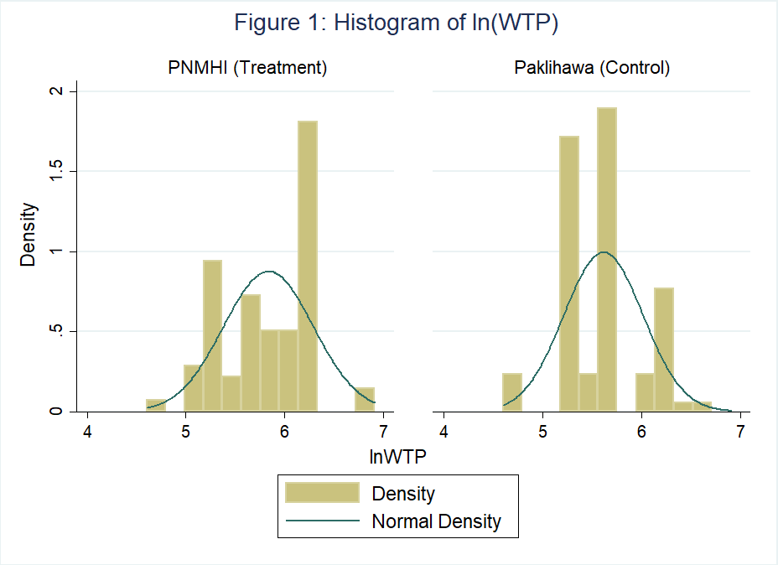

Slide 10
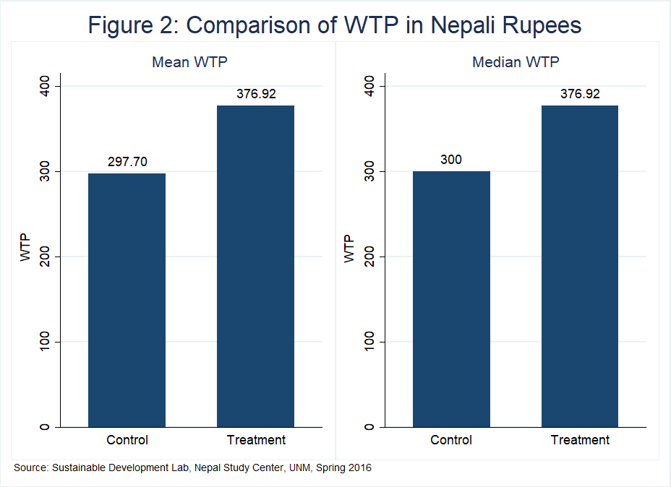

Slide 11
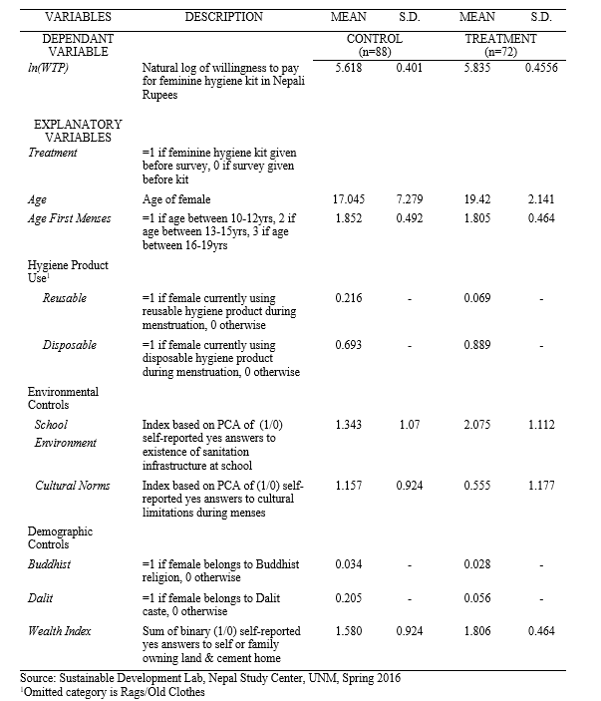

Slide 12
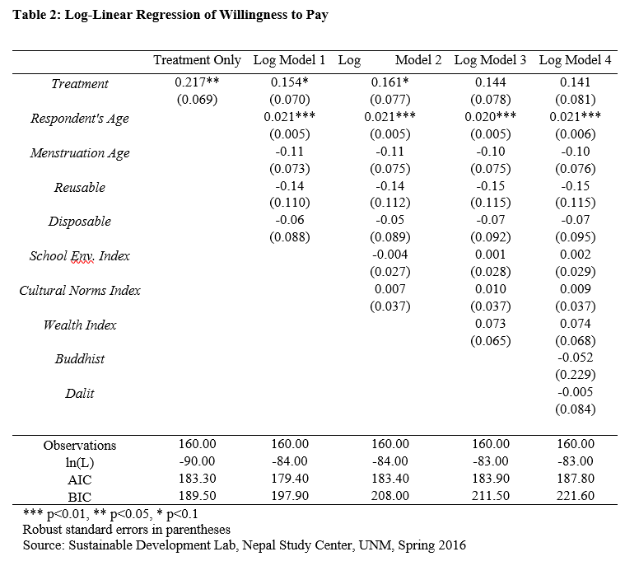

Slide 13
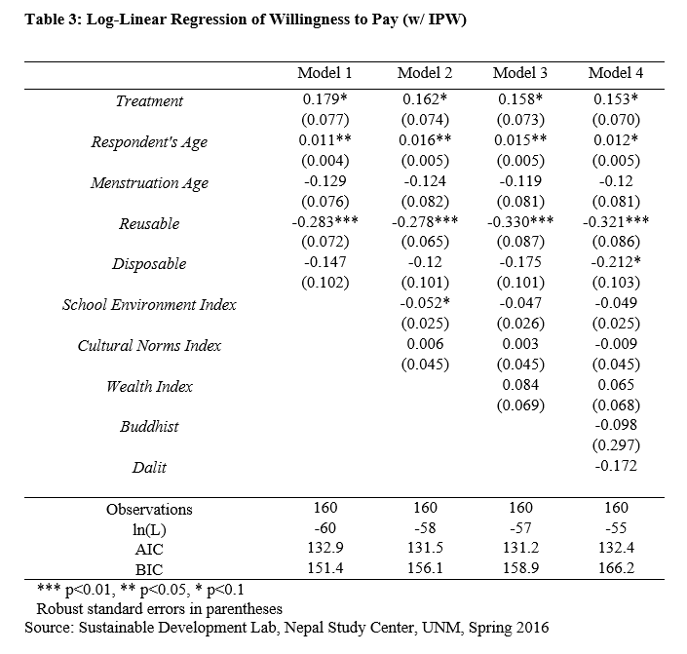
Notes:
Treatment appears to induce between 15.3 & 17.9% increase in WTP
Age increases WTP by around 1.5%
Using reusable product increases WTP by 28-32%

Slide 14
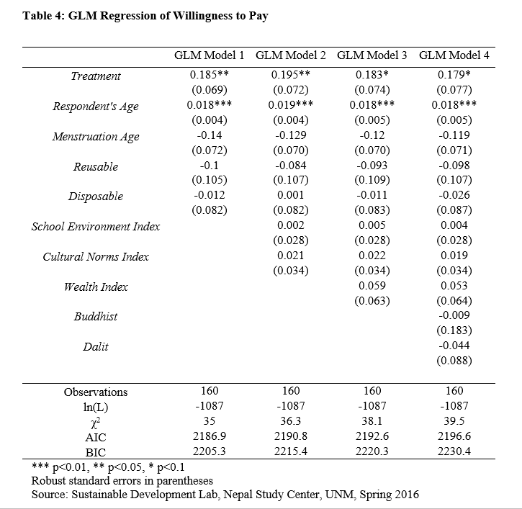

Slide 15
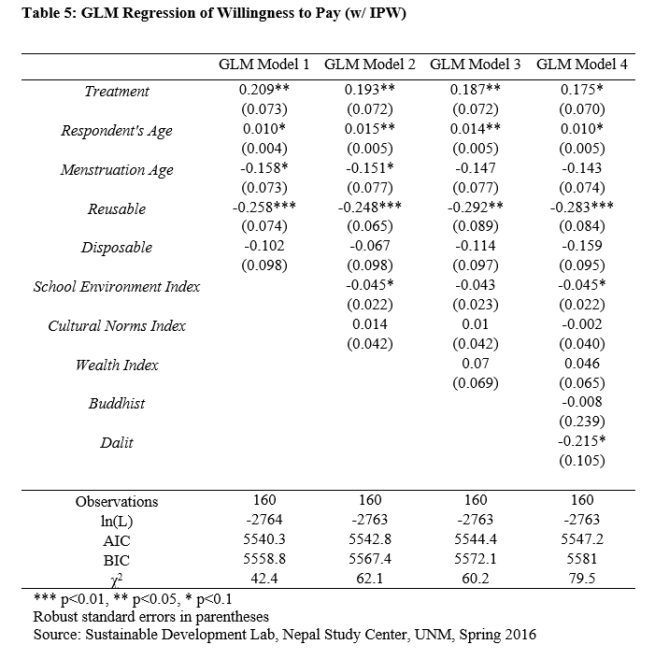
Notes:
Treatment maintains marginal significance even with all controls at 17.5% increase in WTP due to treatment
Age continues to hold around 1-1.5%
Reusable product between 25-29%
Get marginal significance for School Enviroment -4.5% increase in WTP
NOTE: additional robustness check with Box-Cox and there is no loss of sign or significance of treatment variable

Slide 16
Discussion
Regressions support hypothesis that physical contact with the hygiene kits increased WTP, serving as an indicator for willingness to adopt and change hygiene related behavior
Positive effects of age reasonable due to increased income and education with age
Negative effect of using a reusable product likely due to a substitution effect
Potential Bias:
Treatment girls differ along multiple dimensions from those in the control group, including higher reported unhappiness during menstruation → more motivated to seek better solution
Controlling for cultural environment may account for this (Douki et al. 2007; Lee et al. 2009; Jewitt and Ryley 2014)

Slide 17
Conclusions & Policy Implications
There is a need for overall improved health education in Nepal (Acharya, 2010):
Limited training of teachers
Lack of strong central policies/practice regarding sexual education
Lack of parental/community support for health education
Lack of strong empirical supporting evidence of effectiveness of sexual education
That physical contact with the hygiene kits induced higher WTP figures for girls in our study supports the potential for a policy of incorporating more interactive materials in health/hygiene education
May increase effectiveness of any existing or newly developed initiatives

Slide 18
Thank You!

